Slide 1
CO₂ Mobility Control in Carbonate Cores
Consortium Meeting Apr. 29th 2013
Presented by Leyu Cui
Kun Ma, Ramesh Pudasaini, Maura Puerto and George Hirasaki
Sponsored by ADNOC and DOE

Slide 2
Outline
Setup Diagrams
Surfactants and Cores
C12/DI and CO₂ foam
C12/Brine and CO₂ foam
Conclusion

Slide 3
Outline
Setup Diagrams
Surfactants and Cores
C12/DI and CO₂ foam
C12/Brine and CO₂ foam
Conclusion

Slide 4
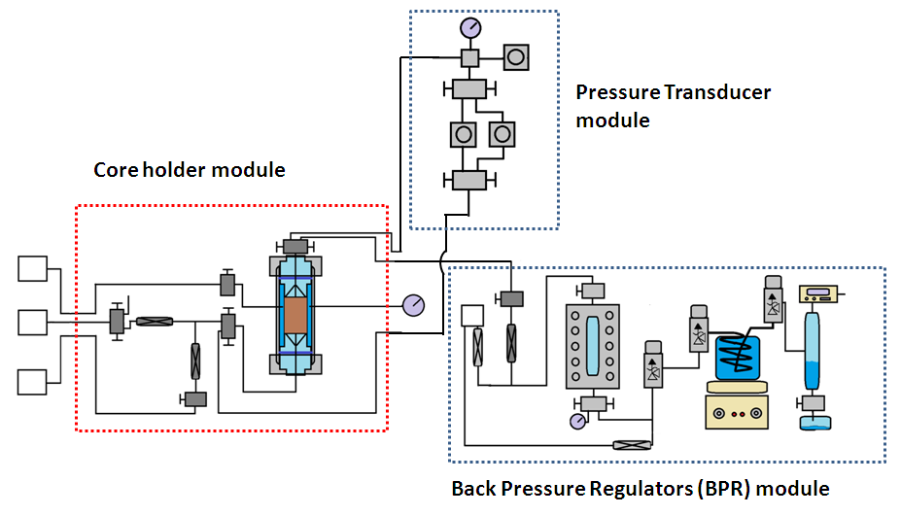
Diagram of the high temperature and high pressure core flooding setup
All wetting materials are Hastelloy Alloys, which can work under high P, T, salinity and low pH.
Pumps System

Slide 5
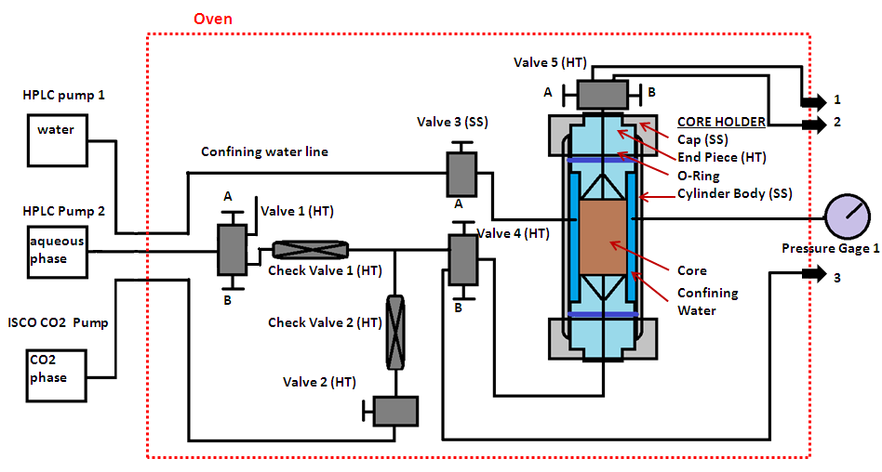
Pumps system and Core Holder Module

Slide 6
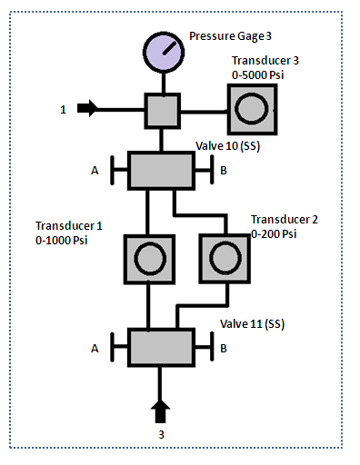
Pressure Transducer Module

Slide 7
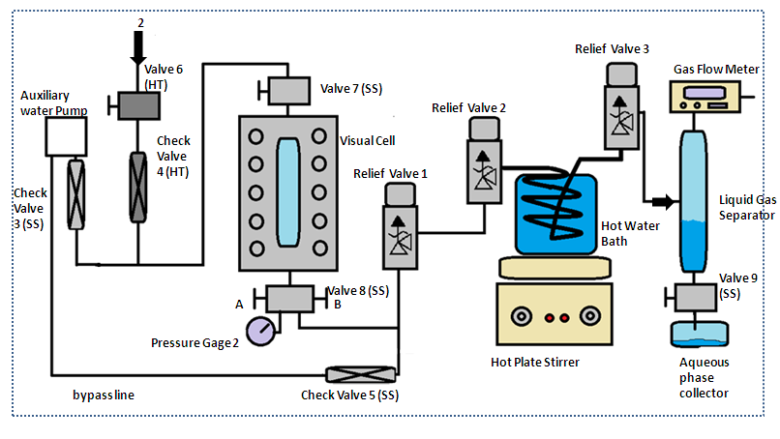
BPR Module

Slide 8
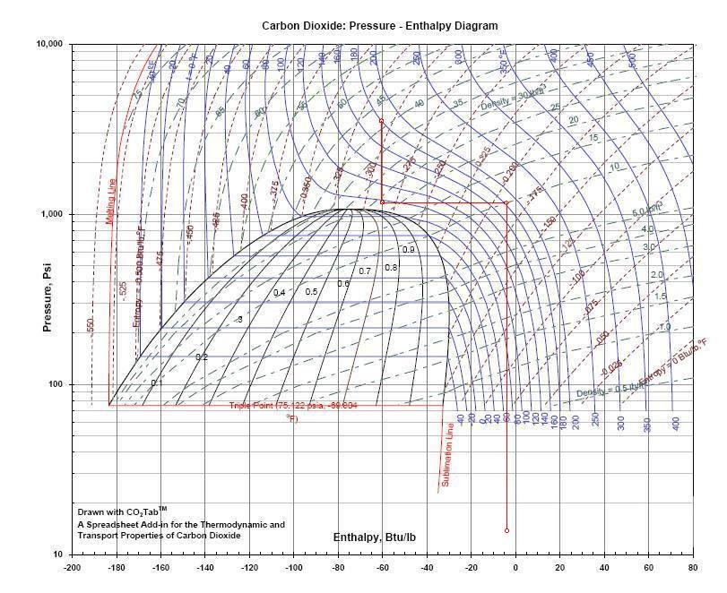
Carbon Dioxide: Pressure-Enthalpy Diagram
3400 psi, 82 ˚C (180 ˚F)
Joule-Thomson Expansion
Isobaric Heating
1200 psi, 35 ˚C
1200 psi, 82 ˚C
Joule-Thomson Expansion
14 .5psi, 15 ˚C
*Good plant design and operation for onshore carbon capture installations and onshore pipelines, Energy Institute, 2010 09,

Slide 9
Outline
Setup Diagrams
Surfactants and Cores
C12/DI and CO₂ foam
C12/Brine and CO₂ foam
Conclusion

Slide 10

Surfactant and Brine
C12: ethoxylated amine from AKZO NOBEL Co. is dissolved in DI water. C12’s molecular weight is 288 g/mol.
R = Coco group (≈ 8 to 16 carbon)
x + y=2
Brine: 22% TDS (total disolved solids) with high divalent ions (Ca²⁺, Mg²⁺) concentrations.

Slide 11
Silurian Dolomite Core
Diameter=1.5 in.
Length= 7.6 cm= 2.99 in.
Permeability is 737 md, measured by water

Slide 12
Outline
Setup Diagrams
Surfactants and Cores
C12/DI and CO₂ foam
C12/Brine and CO₂ foam
Conclusion

Slide 13
Injection Procedure: a slug of CO₂ is injected before C12
WAG is injected to acidify the core to pH <4 before C12 and CO₂ co-injection.
Both WAG and Co-injection have the same foam quality.
1% C12 in DI Water
pH is adjusted by acetic acid
pH of water equilibrium with Dolomite

Slide 14
C12 Plug the Core without CO₂
C12/DI is saturated with CO₂ under 1 atm. The pH is decreased to 5 to dissolved C12 in water at room temperature.

Slide 15
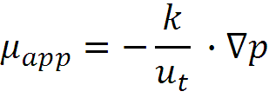



Normalized Pressure Gradient: Apparent Viscosity
Apparent viscosity is used to describe the foam strength, which is calculated by Darcy’s law:
where is foam apparent viscosity, is core permeability, is the total superficial velocity and is the pressure gradient.

Slide 16
C12/DI and CO₂ Foam Pressure History at 20 °C and 3400 psi
30% Foam Quality
50% Foam Quality
µ*=78.91 cp
µ*=118.30 cp
70% Foam Quality
80% Foam Quality
µ*=65.72 cp
µ*=139.98 cp

Slide 17
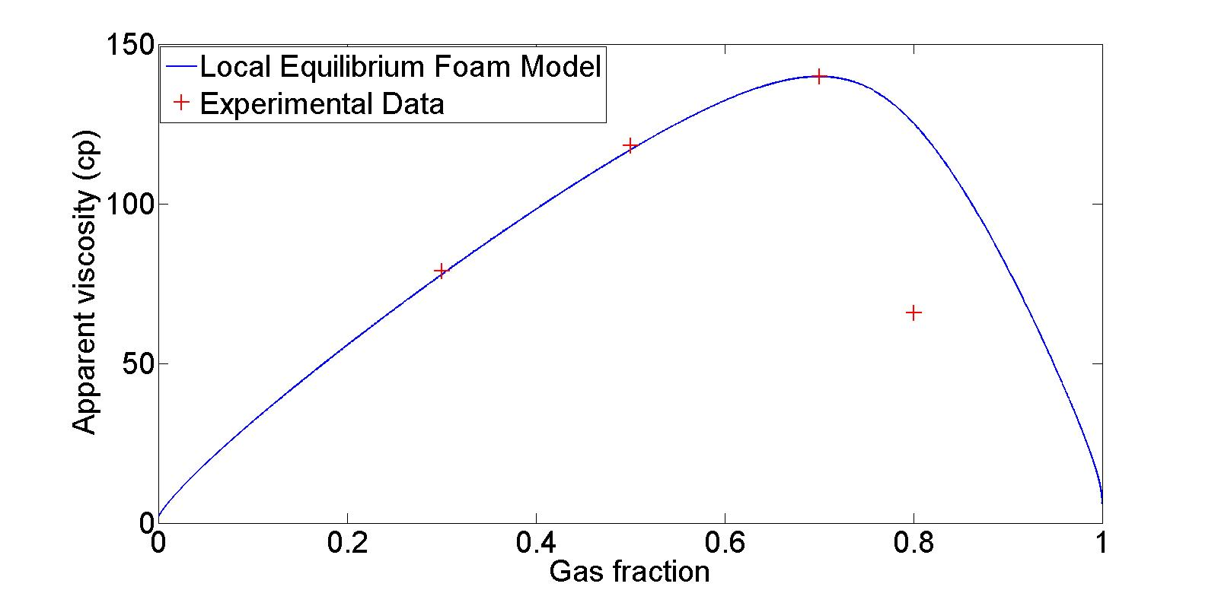
Experimental Data vs. Foam Model for C12/DI and CO₂ foam
krw⁰=0.5; krg⁰=0.1768; S_wc=0.33; S_gr=0.2; n^{w}=2.8; n^{g}=1.1; (Bennion, 2008)
µ_{w}=1 cp; µ_{g}=0.1025 cp;
epdry=200; fmmob=340.99; fmdry=0.39;
(Rossen, W. R. and Renkema, W. J. (2007); Ma, K., Lopez-Salinas, J.L and et al., Energy & Fuels (in press).)

Slide 18
Outline
Setup Diagrams
Surfactants and Cores
C12/DI and CO₂ foam
C12/Brine and CO₂ foam
Conclusion

Slide 19
C12/Brine and CO₂ Foam Pressure History at 20 °C and 3400 psi
30% Foam Quality
50% Foam Quality
70% Foam Quality
80% Foam Quality

Slide 20
Salt may precipitate at high foam quality
90% Foam Quality
90% Foam Quality
Average apparent viscosity
Nadja Mullera, Ran Qib, and et al., CO₂ injection impairment due to halite precipitation, Energy Procedia, Volume 1, Issue 1, 2009
S. Hurter, D. Labregere, and J. Berge, Simulations for CO₂ injection projects with Compositional Simulator, SPE 108540, 2007

Slide 21
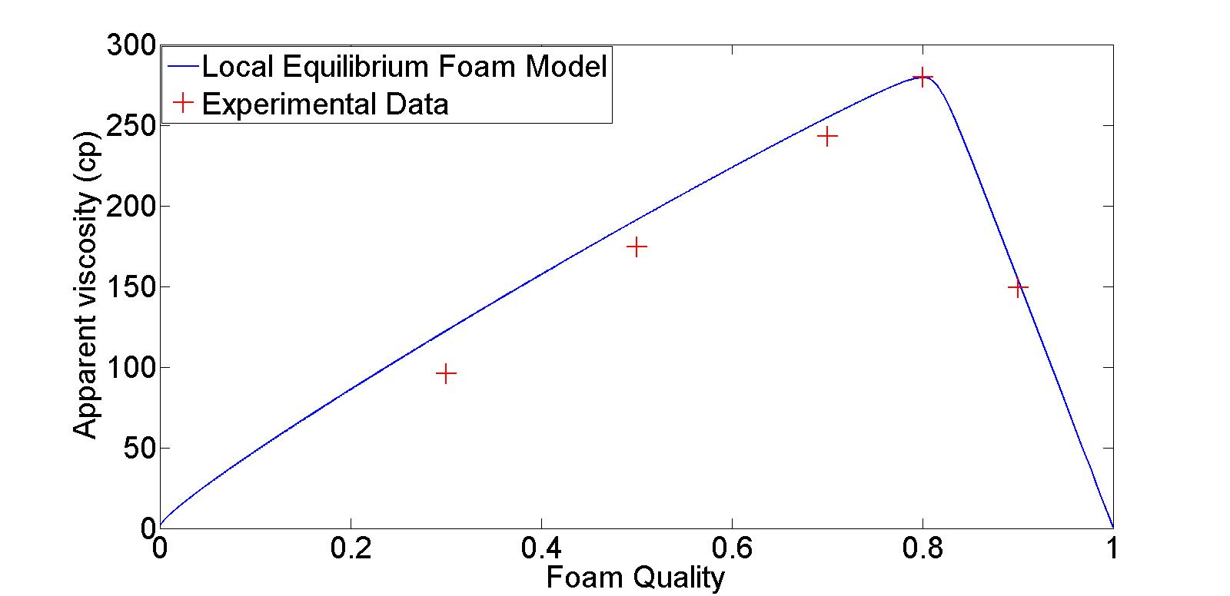
Experimental data vs. Foam model for C12/Brine and CO₂ foam
krw⁰=0.5; krg⁰=0.1768; S_wc=0.33; S_gr=0.2; n^{w}=2.8; n^{g}=1.1; (Bennion, 2008)
µ_{w}=1 cp; µ_{g}=0.1025 cp;
epdry=10000; fmmob= 549.35; fmdry= 0.37;
(Rossen, W. R. and Renkema, W. J. (2007). )

Slide 22
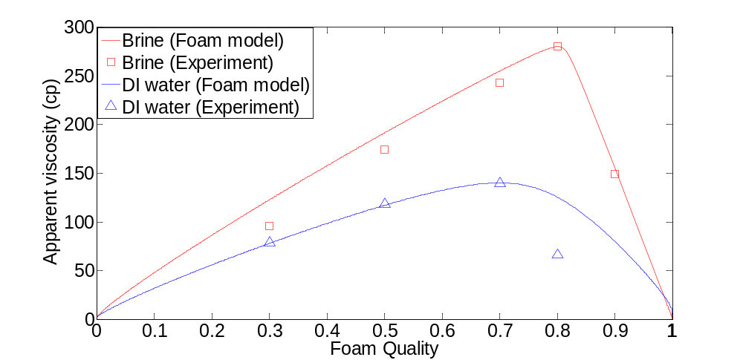
Comparison of Foam in DI water and brine at room temp.

Slide 23
C12/Brine and CO₂ Foam at
120 °C and 3400 psi
µ*=59.14 cp
60% Foam Quality

Slide 24
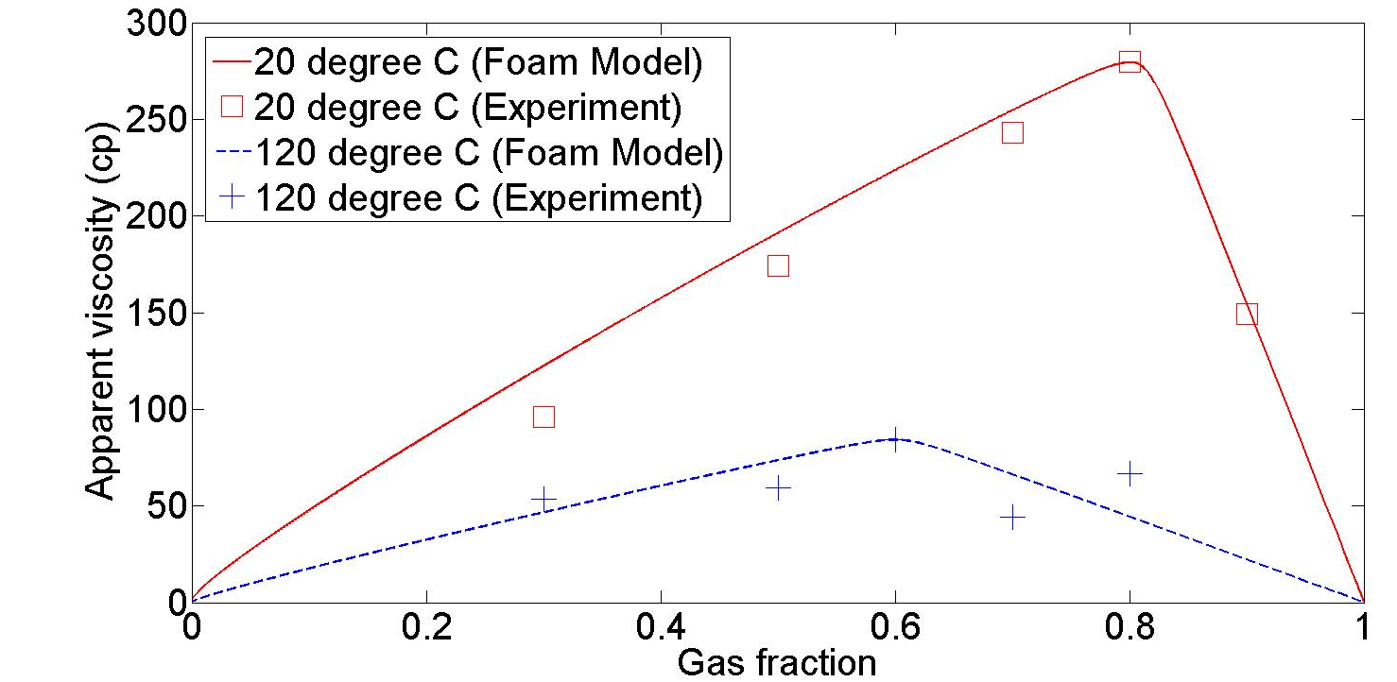
Comparison of viscosity at 20 and 120 °C for C12/Brine and CO₂ Foam
krw⁰=0.5; krg⁰=0.1768; S_wc=0.33; S_gr=0.2; n^{w}=2.8; n^{g}=1.1; (Bennion, 2008)
µ_{w}=0.2381 cp; µ_{g}=3.935×10⁻² cp;
epdry=10000

Slide 25
Conclusion
The cloud point of C12 is lower than room temperature at pH>9. A slug of CO₂ should be injected before C12 solution in carbonate reservoir.
C12 can generate strong foam in a wide range of foam quality. But foam generation is delayed at high foam quality, because the surfactant solution is diluted by residual water.
The foam is stronger in brine than in DI water for C12 and CO₂ foam. The foam strength is reduced at elevated temperature.
The local equilibrium model can fit our experimental data. But this foam model doesn’t include capillary force, solubility factor, et al. which probably caused the difference between the experimental data and calculation result.

Slide 26
Questions?
Thank you!

Slide 27
Back Up

Slide 28
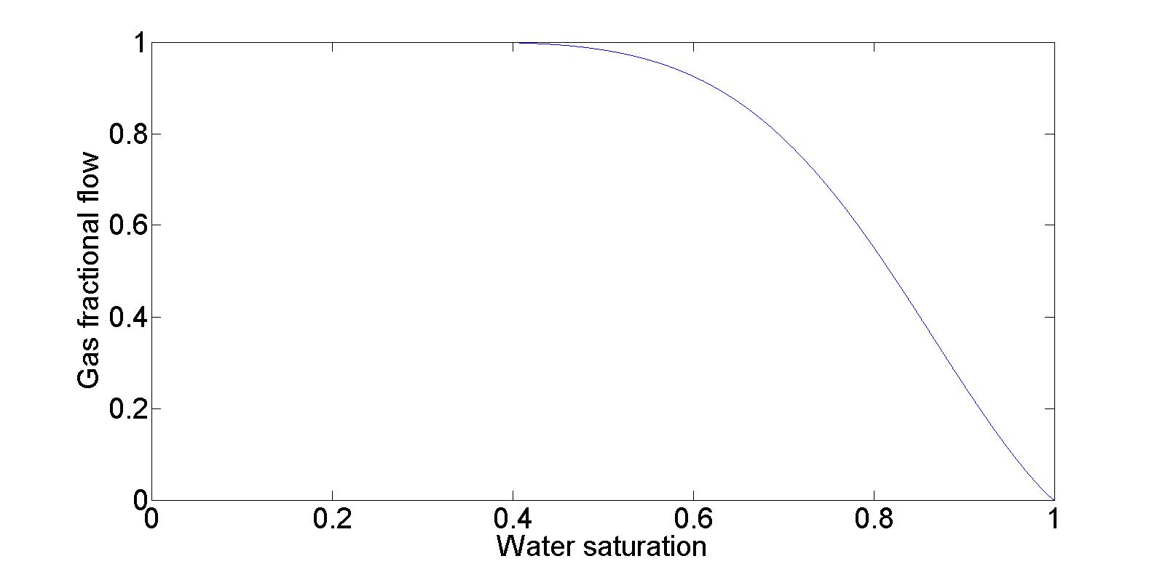
Water saturation doesn’t change too much during WAG

Slide 29
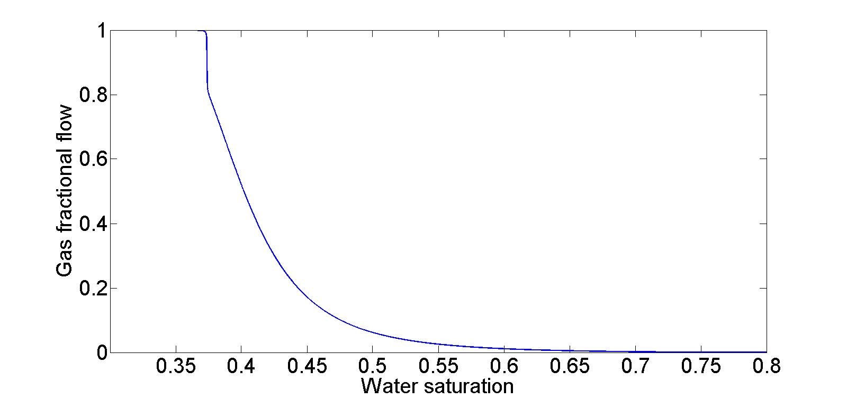
Close to connate water saturation (Swc) at high foam quality

Slide 30
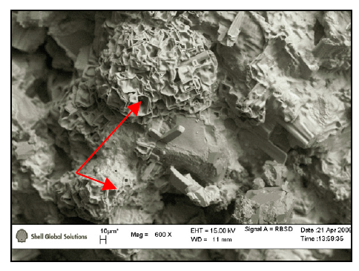
ESEM photograph of Berea sandstone after 32 hrs of CO2 flooding. Red arrows point at Hopper NaCl crystals. (Nadja Mullera, Ran Qib, and et al., CO2 injection impairment due to halite precipitation, Energy Procedia, Volume 1, Issue 1, 2009)

Slide 31
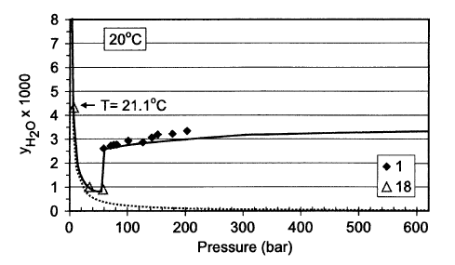
Water evaporation to CO2
N. Spycher, K Pruess, J Ennis-King, CO2- H2O mixtures in the geological sequestration of CO2. I. Assessment and calculation of mutual solubilities from 12 to 100C and up to 600 bar,
Geochimica et Cosmochimica Acta, 67 (16) (2003), pp. 3015–3031
y_{H2O}: mole fraction of H2O in CO2 phase. 0.38% at 20 ˚C and 234 bar.
Convert to volumetric fraction=0.15% .
TDS increase from 22% to (22%*0.1)/(0.1-0.9*0.15%)=22.3% for 90% foam quality.
The increase of total TDS is negligible. But the local CO2 concentration is probably high and results in the high water evaporation.

Slide 32
Step Reduce of BPR to Reach MPG

Slide 33
Increase the flow rate to reach the MPG

Slide 34
MPG vs. MSV (minimum superficial velocity)

Slide 35
Injection Strategy: start at high flow rate to reach the MPG

